Slide 1

模式识别与机器学习
Pattern Recognition & Machine Learning
郭玉柱
yuzhuguo@buaa.edu.cn
自动化科学与电气工程学院
脑机智能实验室
2019春
Lecture Notes：
buaaprml@163.com
Password：prmlbuaa

Slide 2
Main Contents
Linear Classifiers
Fisher Linear Discriminant Analysis
The Perceptron Algorithm
Least Squares Methods
Logistic Discrimination
Support Vector Machines

Slide 3
Linear Classifiers
The Problem: Consider a two class task with ω₁, ω₂

Slide 4
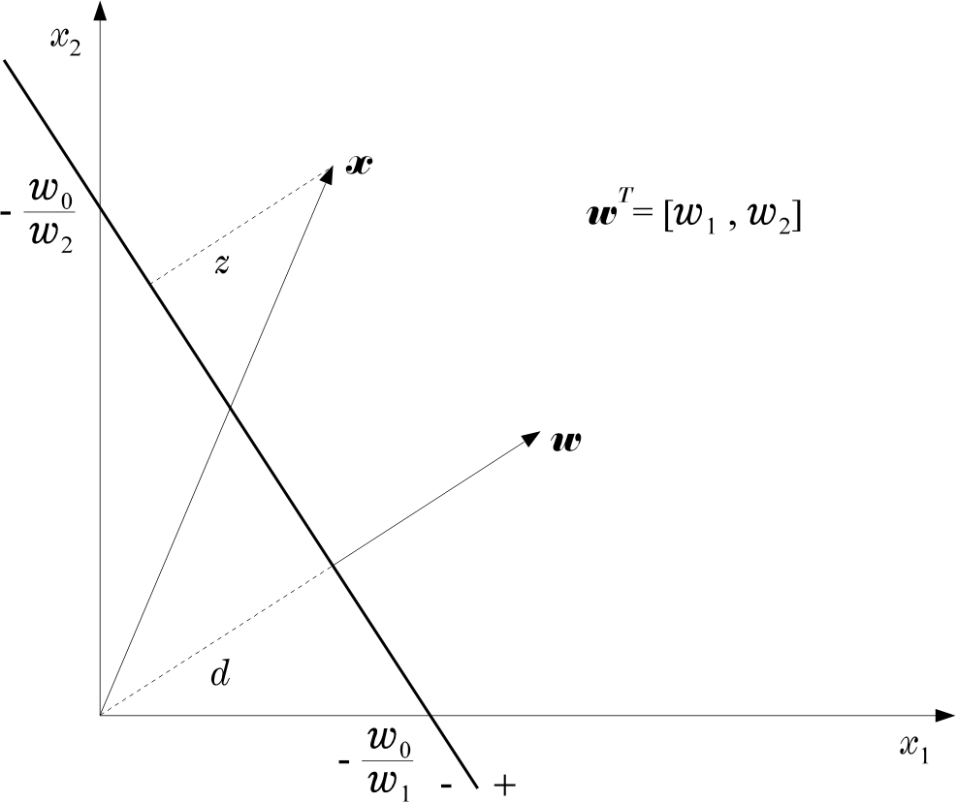
Linear Classifiers
Hence:

Slide 5

Fisher Linear Discriminant
Main idea: find projection to a line s.t. samples from different classes are well separated
Example in 2D
bad line to project to, classes are mixed up
good line to project to, classes are well separated

Slide 6


Fisher Linear Discriminant
Suppose we have 2 classes and d-dimensional samples x₁,…,x_{n} where
n₁ samples come from the first class
n₂ samples come from the second class
consider projection on a line
Let the line direction be given by unit vector v
Scalar v^{t}x_{i} is the distance of projection of x_{i} from the origin
Thus it v^{t}x_{i} is the projection of x_{i} into a one dimensional subspace
x
t
i
v
x_{i}
v

Slide 7

Fisher Linear Discriminant
Thus the projection of sample x_{i} onto a line in direction v is given by v^{t}x_{i}
How to measure separation between projections of different classes?
Let μ~ and μ~ be the means of projections of
1 2
classes 1 and 2
Let μ₁ and μ₂ be the means of classes 1 and 2
▪
μ~ − μ~
1 2
seems like a good measure
similarly ,
μ~ ₂ = v ^{t} μ ₂

Slide 8

Fisher Linear Discriminant
How good is
μ~ − μ~
1 2
as a measure of separation?
The larger μ~ − μ~
, the better is the expected separation
μ₁
1
2
_{μ}~
1
_{μ}~
μ₂
2
μ₁
μ₂
the vertical axes is a better line than the horizontal axes to project to for class separability
however
μ.₁ − μ.₂ > μ~ − μ~
1 2

Slide 9

Fisher Linear Discriminant
The problem with
μ~ − μ~
is that it does not
1 2
consider the variance of the classes
_{μ}~
μ₁
small variance
1
_{μ}~
μ₂
2
μ₁
μ₂
large variance

Slide 10

Fisher Linear Discriminant
We need to normalize proportional to variance
μ~ − μ~
1 2
by a factor which is
₌ 1 _{Σ}^{n}
Have samples z₁,…,z_{n} . Sample mean is μ
z
z
n
i
i = 1
Define their scatter as
n
s = Σ (z − μ
)
2
i z
i = 1
Thus scatter is just sample variance multiplied by n
scatter measures the same thing as variance, the spread of data around the mean
scatter is just on different scale than variance
larger scatter:
smaller scatter:

Slide 11
Fisher Linear Discriminant
_{μ}~
− μ~
Fisher Solution: normalize
Let y_{i} = v^{t}x_{i} , i.e. y_{i} ‘s are the projected samples
Scatter for projected samples of class 1 is
by scatter
1 2
~ 2
= Σ (y − μ
)
s
~
2
1
i
1
y _{i} ∈Class 1
Scatter for projected samples of class 2 is
~ 2
s = Σ (y − μ )
~
2
2
i 2
y _{i} ∈Class 2

Slide 12
Fisher Linear Discriminant
We need to normalize by both scatter of class 1 and scatter of class 2
Thus Fisher linear discriminant is to project on line in the direction v which maximizes
want projected means are far from each other
~
)
2
J (v ) = ^{(μ~}
− μ
~
1
2
s
2
~
2
s
1
2
want scatter in class 1 is as
want scatter in class 2 is as
small as possible, i.e. samples small as possible, i.e. samples
of class 1 cluster around the
of class 2 cluster around the
projected mean μ~
projected mean μ~
1
2

Slide 13

Fisher Linear Discriminant
~
)
2
J (v ) = ^{(μ~}
− μ
~
1
2
s
2
~
2
s
1 2
If we find v which makes J(v) large, we are guaranteed that the classes are well separated
projected means are far from each other
_{μ}~
_{μ}~
1
2
small s~ implies that
small s~ implies that
projected¹ samples of class 1 are clustered around projected mean
2
projected samples of class 2 are clustered around projected mean

Slide 14
Fisher Linear Discriminant Derivation
~
)
2
J (v ) = ^{(μ~}
− μ
~
1
2
s
2
~
2
s
1 2
All we need to do now is to express J explicitly as a function of v and maximize it
straightforward but need linear algebra and Calculus
Define the separate class scatter matrices S₁ and S₂ for classes 1 and 2. These measure the scatter of original samples x_{i} (before projection)
S = Σ (x
x _{i} ∈Class 1
S = Σ (x
x _{i} ∈Class 2
− μ )(x − μ )
T
cov
1
i
1 i 1
− μ )(x − μ )
T
2
i
2
i
2

Slide 15
Fisher Linear Discriminant Derivation
Now define the within the class scatter matrix
S_{W} = S₁ + S₂
~ 2
= Σ (y − μ )
Recall that s
~
2
1
i
1
y _{i} ∈Class 1
~
μ
= v μ
Using y_{i} = v^{t}x_{i} and
t
1
1
= Σ (v ^{t} x − v μ )
= Σ (v ^{t} (x − μ
=
=
~ 2
t
2
s
1
i
1
y _{i} ∈Class 1
)) ( (
t
v x − μ ))
t
i
1
i
1
y _{i} ∈Class 1
Σ ((x − μ
) ) (( ) )
t
t
t
v x − μ
v
i
1
i
1
y _{i} ∈Class 1
Σ v ^{t} (x − μ )(x − μ )
t
v
t
= v S v
i
1
i
1
1
y _{i} ∈Class 1

Slide 16
Fisher Linear Discriminant Derivation
Similarly s
Therefore s
Define between the class scatter matrix
~
2
= v ^{t} S v
2
2
~ 2 ~ 2
s = v ^{t} S₁v + v ^{t} S₂v = v ^{t} S v
1 2
W
S = (μ − μ )(μ − μ )
t
B 1 2 1 2
S_{B} measures separation between the means of two classes (before projection)
Let’s rewrite the separations of the projected means
(μ~ − μ
)
= (v ^{t} μ − v μ )
~
2
t
2
1
2
1 2
= v ^{t} (μ − μ )(μ − μ ) v
t
1
= v ^{t} S_{B}v
2 1 2

Slide 17
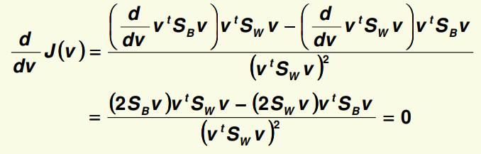
Fisher Linear Discriminant Derivation
Thus our objective function can be written:
(μ~ − μ )
~
2
v ^{t} S v
J (v ) =
1 2
=
B
~ 2
~ 2
s
s v ^{t} S v
1 2 W
Minimize J(v) by taking the derivative w.r.t. v and setting it to 0

Slide 18
Fisher Linear Discriminant Derivation
Need to solve
v ^{t} S_{W} v (S_{B} v ) − v ^{t} S_{B}v (S_{W} v ) = 0
→ v ^{t} S_{W} v (S_{B} v ) ₋ v ^{t} S_{B}v (S_{W} v ) ₌ ₀
v ^{t} S_{W} v v ^{t} S_{W} v
t
v (S v )
v S
→ S v −
B W
= 0
B
v ^{t} S_{W} v
= λ
→ S_{B}v = λ S_{W} v
generalized eigenvalue problem

Slide 19
Fisher Linear Discriminant Derivation
S_{B}v = λ S_{W} v
If S_{W} has full rank (the inverse exists), can convert this to a standard eigenvalue problem
S ⁻¹S v = λ v
W B
But S_{B} x for any vector x, points in the same
direction as μ₁ - μ₂
α
S x = (μ − μ )(μ − μ )
t
x
= (μ − μ )((μ − μ ) )
= α (μ − μ )
B 1 2 1 2
t
x
1 2 1 2
1 2
Thus can solve the eigenvalue problem immediately
(
μ − μ )
v = S
−1
W 1
2
= α [S μ − μ )]
λ
S S [ μ − μ ] = S
[ ( )]
(
− 1
W B W
( )
α μ − μ
− 1
− 1
S
−1
W
1 2
1 2
W 1 2
v
v

Slide 20
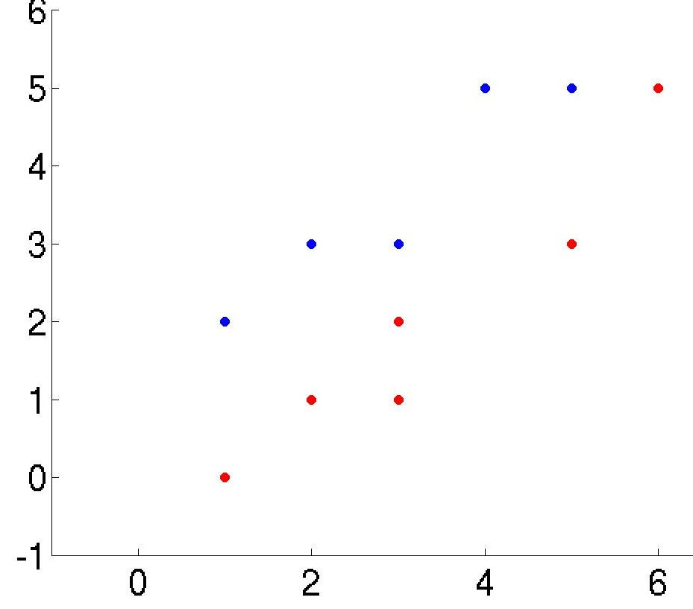
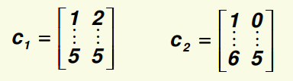
Fisher Linear Discriminant Example
Data
Class 1 has 5 samples c₁=[(1,2),(2,3),(3,3),(4,5),(5,5)]
Class 2 has 6 samples c₂=[(1,0),(2,1),(3,1),(3,2),(5,3),(6,5)]
Arrange data in 2 separate matrices
Notice that PCA performs very poorly on this data because the direction of largest variance is not helpful for classification

Slide 21



Fisher Linear Discriminant Example
First compute the mean for each class
μ₁ = mean (c₁ ) = [3 3.6 ] μ ₂ = mean (c₂ ) = [3.3 2 ]
Compute scatter matrices S₁ and S₂ for each class
Within the class scatter:
S_{W} = S₁ + S₂
it has full rank, don’t have to solve for eigenvalues
The inverse of S
W
Finally, the optimal line direction v

Slide 22
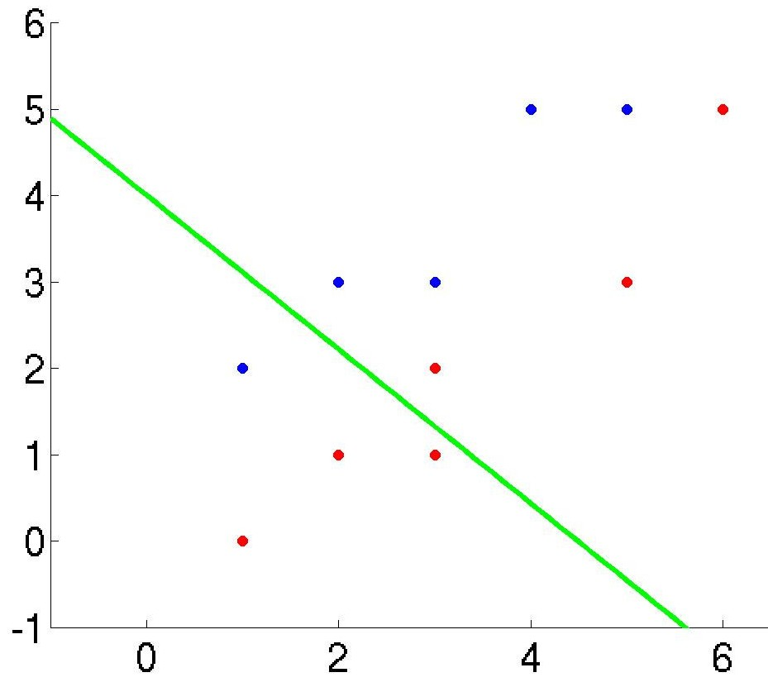
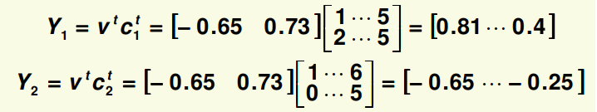
Fisher Linear Discriminant Example
Notice, as long as the line has the right direction, its exact position does not matter
Last step is to compute the actual 1D vector y. Let’s do it separately for each class

Slide 23
FDA Drawbacks
Reduces dimension only to k = c-1 (unlike PCA)
For complex data, projection to even the best line may result in unseparable projected samples
Will fail:
1. J(v) is always 0: happens if μ₁ = μ₂
~
)
2
J (v ) = ^{(μ~}
− μ
~
1
2
s
2
~
2
s
1 2
PCA performs
PCA also
reasonably well
fails:
here:
2. If J(v) is always large: classes have large overlap when projected to any line (PCA will also fail)

Slide 24
The Perceptron Algorithm
Assume linearly separable classes, i.e.,
The case falls under the above formulation, since

Slide 25
The Perceptron Algorithm
Our goal: Compute a solution, i.e., a hyperplane w, so that
The steps
Define a cost function to be minimized
Choose an algorithm to minimize the cost function
The minimum corresponds to a solution

Slide 26
The Perceptron Algorithm
The Cost Function
Where Y is the subset of the vectors wrongly classified by w. When Y=(empty set) a solution is achieved and

Slide 27
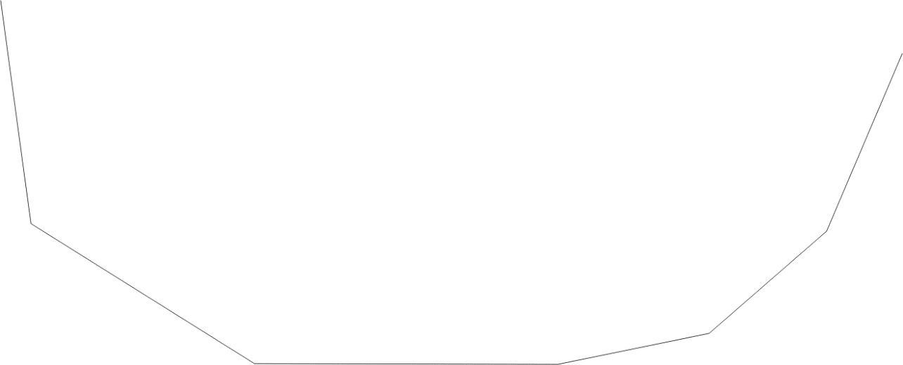
The Perceptron Algorithm
J(w) is piecewise linear (WHY?)
The Algorithm
The philosophy of the gradient descent is adopted.

Slide 28
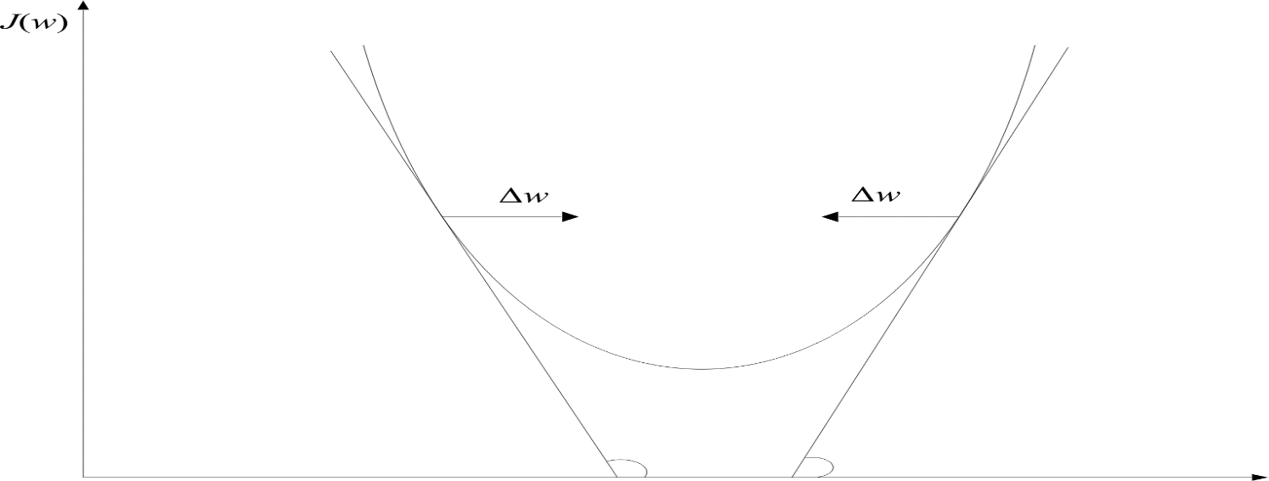
The Perceptron Algorithm
Wherever valid
This is the celebrated Perceptron Algorithm

Slide 29
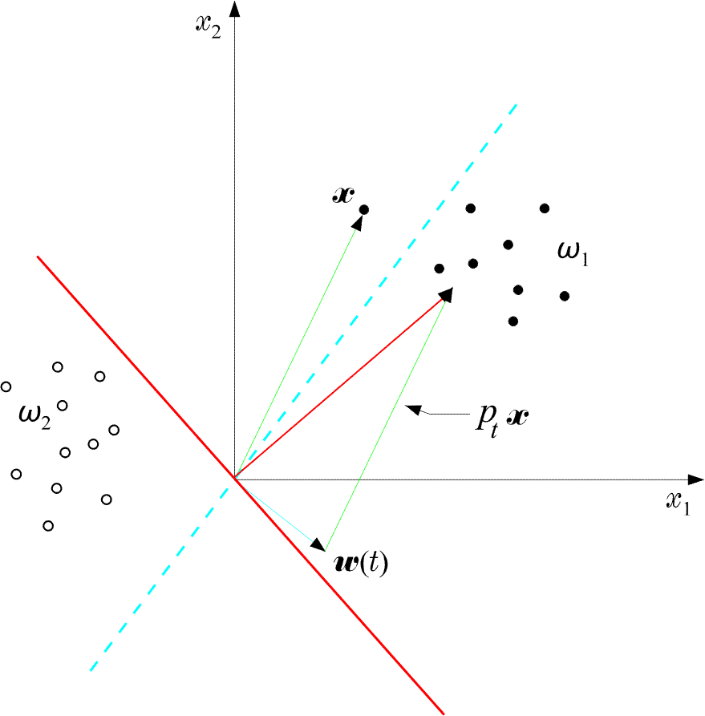
The Perceptron Algorithm
An example:
The perceptron algorithm converges in a finite number of iteration steps to a solution if

Slide 30
The Perceptron Algorithm
A useful variant of the perceptron algorithm
It is a reward and punishment type of algorithm

Slide 31
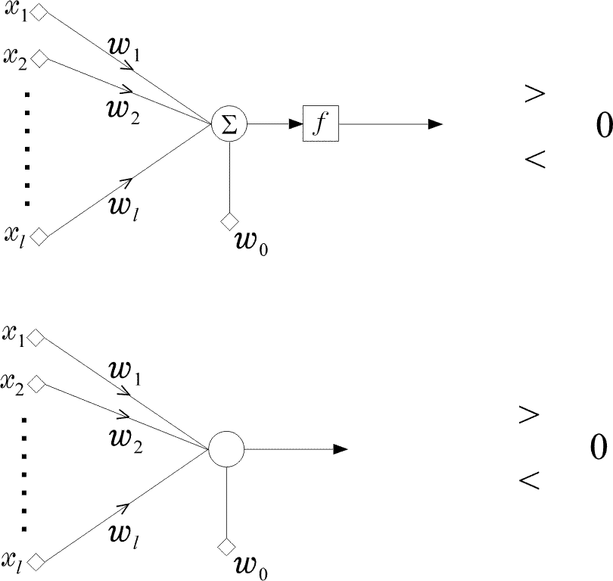
The Perceptron Algorithm
The perceptron
The network is called perceptron or neuron
It is a learning machine that learns from the training vectors via the perceptron algorithm

Slide 32
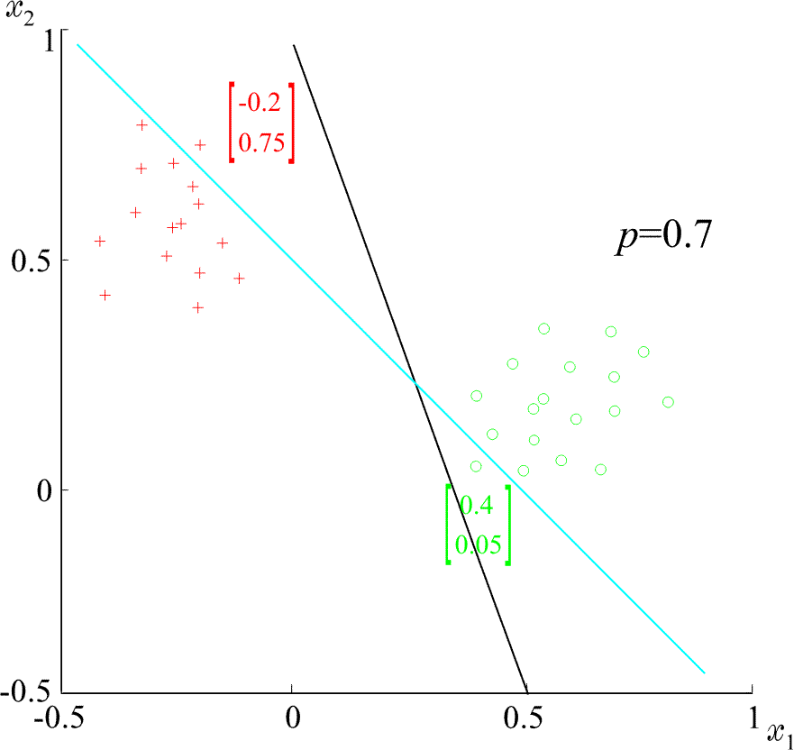
The Perceptron Algorithm
Example: At some stage t the perceptron algorithm
results in
The corresponding hyper plane is

Slide 33
Least Squares Methods
If classes are linearly separable, the perceptron output results in
If classes are NOT linearly separable, we shall compute the weights
so that the difference between
The actual output of the classifier, , and
The desired outputs, e.g.
to be SMALL

Slide 34
Least Squares Methods
SMALL, in the mean square error sense, means to choose so that the cost function

Slide 35
Least Squares Methods
Minimizing
where R_{x} is the autocorrelation matrix
and the crosscorrelation vector

Slide 36
Least Squares Methods
Multi-class generalization
The goal is to compute M linear discriminant functions:
according to the MSE.
Adopt as desired responses y_{i}:
Let
And the matrix

Slide 37
Least Squares Methods
The goal is to compute :
The above is equivalent to a number M of MSE minimization problems. That is:
Design each so that its desired output is 1 for and 0 for any other class.
Remark: The MSE criterion belongs to a more general class of cost function with the following important property:
The value of is an estimate, in the MSE sense, of the
a-posteriori probability , provided that the desired responses used during training are and 0 otherwise.

Slide 38
Least Squares Methods
Mean square error regression: Let , be jointly distributed random vectors with a joint pdf
The goal: Given the value of estimate the value of . In the pattern recognition framework, given one wants to estimate the respective label .
The MSE estimate of given is defined as:
It turns out that:
The above is known as the regression of given and it is, in general, a non-linear function of . If is Gaussian the MSE regressor is linear.

Slide 39
Least Squares Methods
SMALL in the sum of error squares sense means
that is, the input x_{i} and its
corresponding class label (±1).

Slide 40
Least Squares Methods
Pseudoinverse Matrix
Define

Slide 41
Least Squares Methods
Thus
Assume N=l X square and invertible. Then
Pseudoinverse of X

Slide 42
Least Squares Methods
Assume N>l. Then, in general, there is no solution to satisfy all equations simultaneously:
The “solution” corresponds to the minimum sum of squares solution

Slide 43
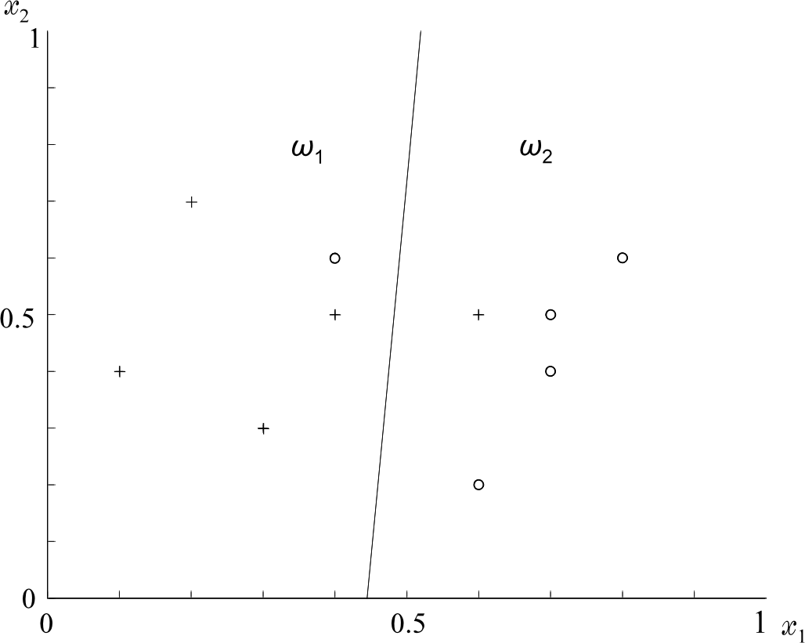
Least Squares Methods
Example:

Slide 44
Least Squares Methods

Slide 45
Least Squares Methods
The Bias – Variance Dilemma
A classifier is a learning machine that tries to predict the class label y of . In practice, a finite data set D is used for its training. Let us write . Observe that:
For some training sets, , the training may result to good estimates, for some others the result may be worse.
The average performance of the classifier can be tested against the MSE optimal value, in the mean squares sense, that is:
where E_{D} is the mean over all possible data sets D.

Slide 46
Least Squares Methods
The above is written as:
In the above, the first term is the contribution of the bias and the second term is the contribution of the variance.
For a finite D, there is a trade-off between the two terms. Increasing bias it reduces variance and vice verse. This is known as the bias-variance dilemma.
Using a complex model results in low-bias but a high variance, as one changes from one training set to another. Using a simple model results in high bias but low variance.

Slide 47
Logistic Discrimination
Let an -class task, . In logistic discrimination, the logarithm of the likelihood ratios are modeled via linear functions, i.e.,
Taking into account that
it can be easily shown that the above is equivalent with modeling posterior probabilities as:

Slide 48
Logistic Discrimination
For the two-class case it turns out that

Slide 49
Logistic Discrimination
The unknown parameters are usually estimated by maximum likelihood arguments.
Logistic discrimination is a useful tool, since it allows linear modeling and at the same time ensures posterior probabilities to add to one.

Slide 50
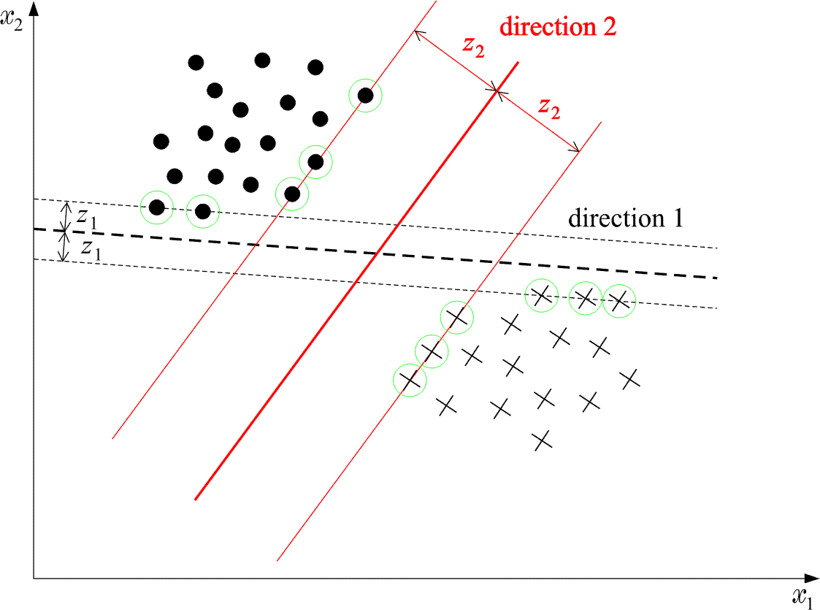
Support Vector Machines
The goal: Given two linearly separable classes, design the classifier that leaves the maximum margin from both classes

Slide 51
Support Vector Machines
Margin: Each hyperplane is characterized by
Its direction in space, i.e.,
Its position in space, i.e.,
For EACH direction, , choose the hyperplane that leaves the SAME distance from the nearest points from each class. The margin is twice this distance.

Slide 52
Support Vector Machines
The distance of a point from a hyperplane is given by
Scale, so that at the nearest points from each class the discriminant function is ±1:
Thus the margin is given by
Also, the following is valid

Slide 53
Support Vector Machines
SVM (linear) classifier
Minimize
Subject to
The above is justified since by minimizing
the margin is maximised

Slide 54
Support Vector Machines
The above is a quadratic optimization task, subject to a set of linear inequality constraints. The Karush-Kuhh-Tucker conditions state that the minimizer satisfies:
(1)
(2)
(3)
(4)
Where is the Lagrangian

Slide 55
Support Vector Machines
The solution: from the above, it turns out that

Slide 56
Support Vector Machines
Remarks:
The Lagrange multipliers can be either zero or positive. Thus,
where , corresponding to positive Lagrange multipliers
From constraint (4) above, i.e.,
the vectors contributing to

Slide 57
Support Vector Machines
Remarks:
The Lagrange multipliers can be either zero or positive. Thus,
where , corresponding to positive Lagrange multipliers
From constraint (4) above, i.e.,
the vectors contributing to

Slide 58
Support Vector Machines
Dual Problem Formulation
The SVM formulation is a convex programming problem, with
Convex cost function
Convex region of feasible solutions
Thus, its solution can be achieved by its dual problem, i.e.,
maximize
subject to
λ

Slide 59
Support Vector Machines
Combine the above to obtain
maximize
subject to
λ

Slide 60
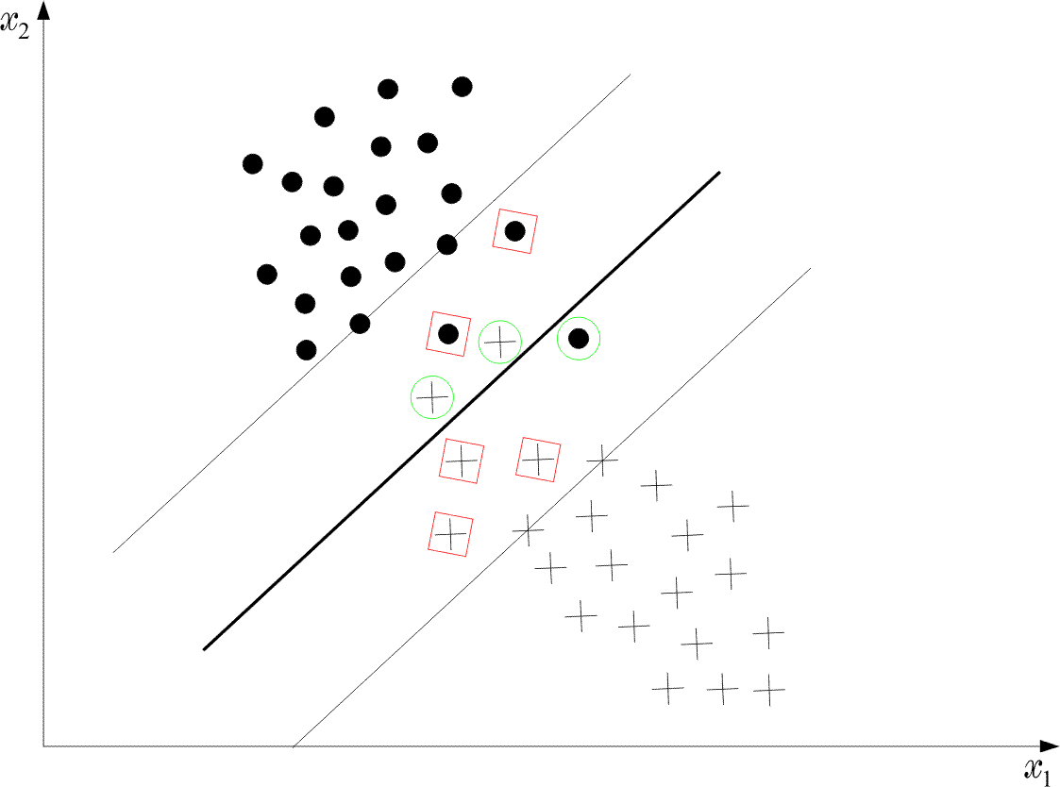
Support Vector Machines
Remarks:
Support vectors enter via inner products
Non-Separable classes

Slide 61
Support Vector Machines
In this case, there is no hyperplane such that
Recall that the margin is defined as twice the distance between the following two hyperplanes

Slide 62
Support Vector Machines
The training vectors belong to one of three possible categories
1) Vectors outside the band which are correctly classified, i.e.,
2) Vectors inside the band, and correctly classified, i.e.,
3) Vectors misclassified, i.e.,

Slide 63
Support Vector Machines
All three cases above can be represented as
1)
2)
3)
are known as slack variables

Slide 64
Support Vector Machines
The goal of the optimization is now two-fold
Maximize margin
Minimize the number of patterns with ,
One way to achieve this goal is via the cost
where C is a constant and
I(.) is not differentiable. In practice, we use an approximation
Following a similar procedure as before we obtain

Slide 65
Support Vector Machines
KKT conditions

Slide 66
Support Vector Machines
The associated dual problem
Maximize
subject to
Remarks: The only difference with the separable class case is the existence of in the constraints

Slide 67
Support Vector Machines
Training the SVM
A major problem is the high computational cost. To this end, decomposition techniques are used. The rationale behind them consists of the following:
Start with an arbitrary data subset (working set) that can fit in the memory. Perform optimization, via a general purpose optimizer.
Resulting support vectors remain in the working set, while others are replaced by new ones (outside the set) that violate severely the KKT conditions.
Repeat the procedure.
The above procedure guarantees that the cost function decreases.
Platt’s SMO algorithm chooses a working set of two samples, thus analytic optimization solution can be obtained.

Slide 68
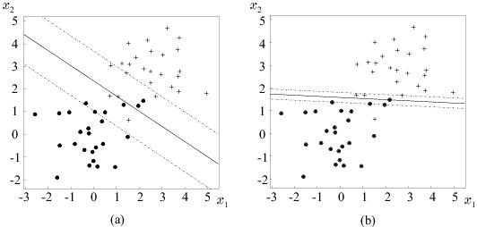
Support Vector Machines
Multi-class generalization
Although theoretical generalizations exist, the most popular in practice is to look at the problem as M two-class problems (one against all).
Example:
Observe the effect of different values of C in the case of non-separable classes.

Slide 69



Q&A
Notes:
69
69

